Slide 1
Carnatic Beat Analysis
What is that beat cycle?
by Anand Subbaraman

Slide 2
Introduction and Background
This project develops ML/AI classifiers to identify the Carnatic beat (taalam) of a mridangam solo.
In the South Indian classical music genre (also called Carnatic music), the concept of rhythm is very well developed and sophisticated.
Every song/composition follows a certain beat cycle called taalam.
During a concert, the percussionist, who typically plays a hand drum called mridangam, performs a drum solo where he/she improvises on the taalam of the preceding song.
The percussion solo can last from 5 to 10 minutes to as much as 30 to 40 minutes.

Slide 3

Project Goal
Given an audio clip of a drum solo, identify the taalam (beat cycle) in which it is performed.
5 popular taalam (beat cycle) types, thousands possible in principle.
The scope of this project is restricted to 3 well-known taalams.
Aadi (8-beat cycle), mishra-chapu (7-beat cycle) and khanda-chapu (5-beat cycle)
Below are two clips of an 8-beat solo and a 5-beat solo. Can you tell which is which?

Slide 4
Motivation and Business Case
About 100 to 120 million Carnatic music listeners worldwide.
“Search by beat” functionality can be offered to users of music streaming services.
Education, Catalog and Archival: A large number of recordings currently on tape (example All India Radio archives) can be digitized and automatically categorized by beat.
Curiosity/Exploration: Can ML/AI techniques be brought to bear to identify and classify Carnatic beats? Can ML/AI approach human expertise?

Slide 5
Data Sources
Raw data is simply an audio clip - say in mp3 format.
Numerous video and audio recordings of Carnatic music concerts, including the drum solo portion, are available on the internet.
YouTube (video) and SangeethaPriya.org (audio) host a large number of
high-quality recordings.
Several private collections and an active aficionado community who swap recordings.

Slide 6
Data Generation:
Vectorize Sound Intensity
Raw data (audio file) has to be transformed into a format suitable for analysis.
Idea: generate a series of time stamps corresponding to each drum beat.
A drum beat = a sudden rise in sound intensity (a spike) with respect to the background intensity.

Slide 7
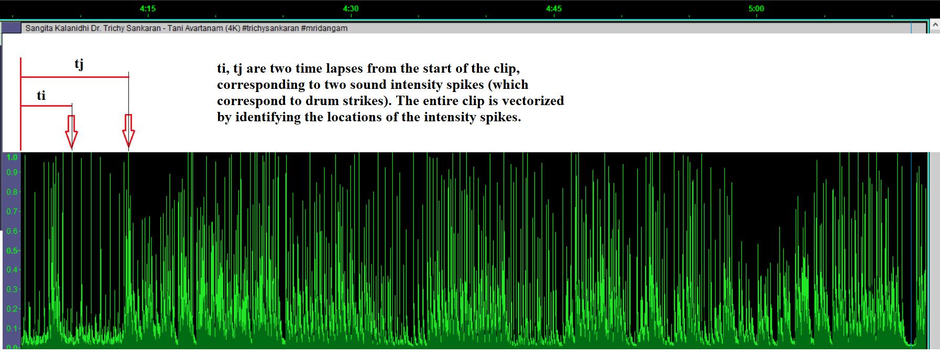
Sound Intensity Vectorization: Image Analysis
Ideally, analyze the mp3 file and detect intensity spikes. But - requires mp3 file format expertise.
Idea: Create an image of the sound intensity by taking the screenshot of the waveform in Audacity (a popular open-source app for audio editing and recording).
Analyze the image to detect spikes in intensity (drum beats)

Slide 8
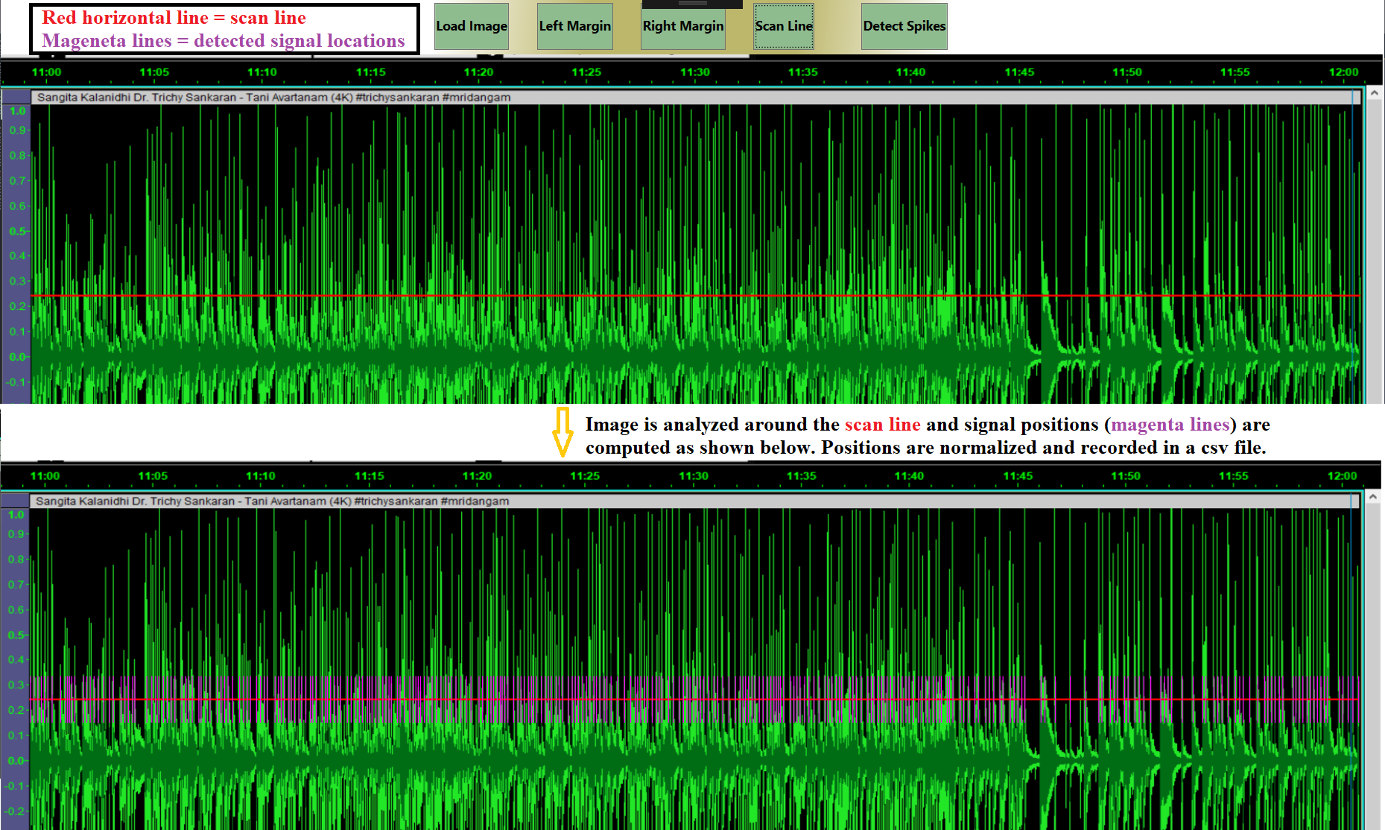
Custom Image Analysis App
Developed for this project (runs on Windows only). Scans the image to detect spikes.
Generates a vector of timestamps of the spike locations, normalized to 1. Screenshot below.

Slide 9
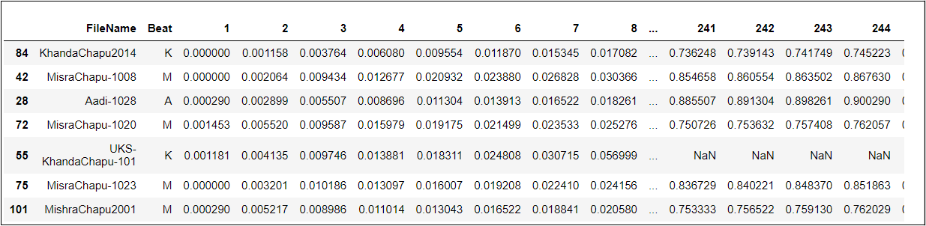
Data Samples
Each data row corresponds to one audio clip, approximately 1 to 1.5 minutes long
When vectorized, a clip produces about of 200 to 350 timestamps (features).
250 timestamps retained for each row, extra columns discarded.
Shorter clips are dropped during analysis. No way to fill in missing values!
Target = ‘Beats’ column. 3 classes of beat cycles: A (8-beat), K (5-beat) and M (7-beat)
117 data points only. Very small dataset, generated manually. Well-balanced between classes.

Slide 10
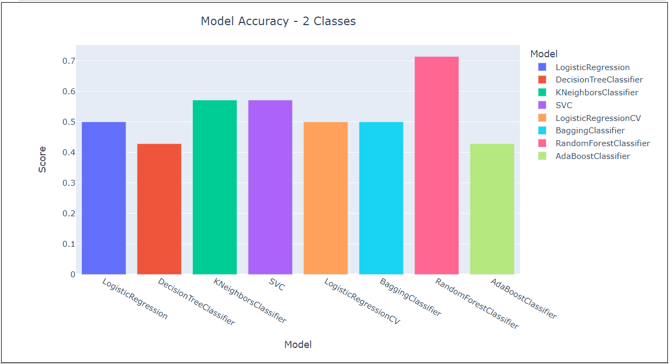
Exploratory Data Analysis - 1
Classification problem: given an audio clip of a drum solo, which beat does it correspond to?
Preliminary analysis using 2 classes only to check feasibility of the approach.
(computation details in Jupyter notebook ASubbaraman-CarnaticBeatAnalysis-2.ipynb)
Several ‘classic’ classifiers were applied to the data, no hyperparameter tuning.
RandomForest
accuracy > 70%
(random guess = 50%)
Reasonable results, given the small dataset.

Slide 11
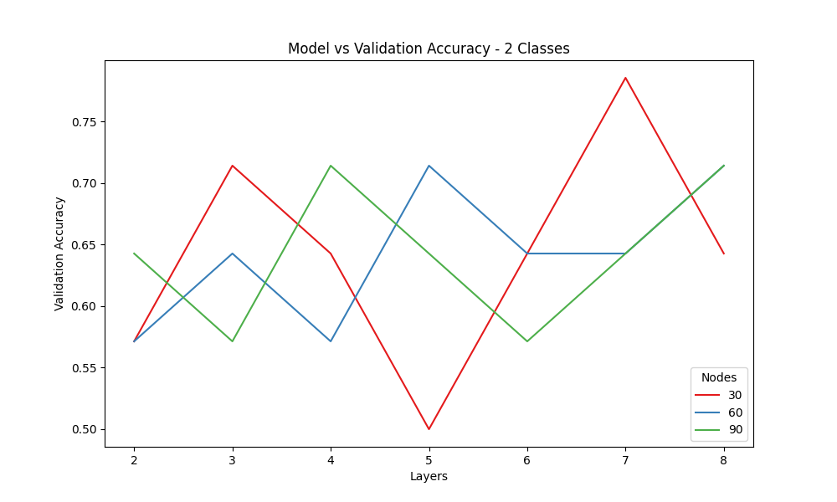
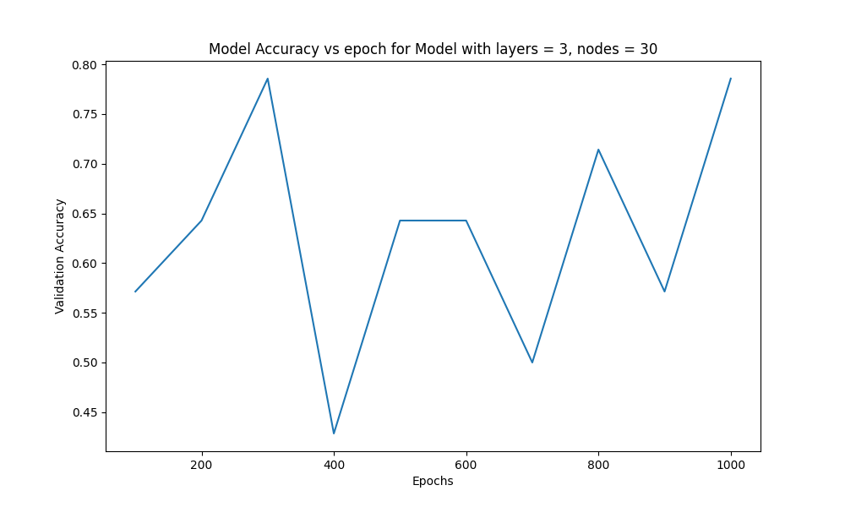
Exploratory Data Analysis - 2
Preliminary analysis using 2 classes only to check the feasibility of using Neural Nets.
(computation details in Jupyter notebook ASubbaraman-CarnaticBeatAnalysis_NN_2Classes.ipynb)
Accuracy vs number of epochs for a typical model. Dependence is already asymptotic. Will use epochs = 100 in the detailed analysis.
Neural Net accuracy approaches 80% (example model with 7 hidden layers, 30 neurons per layer).
Reasonable results, given the small dataset.

Slide 12
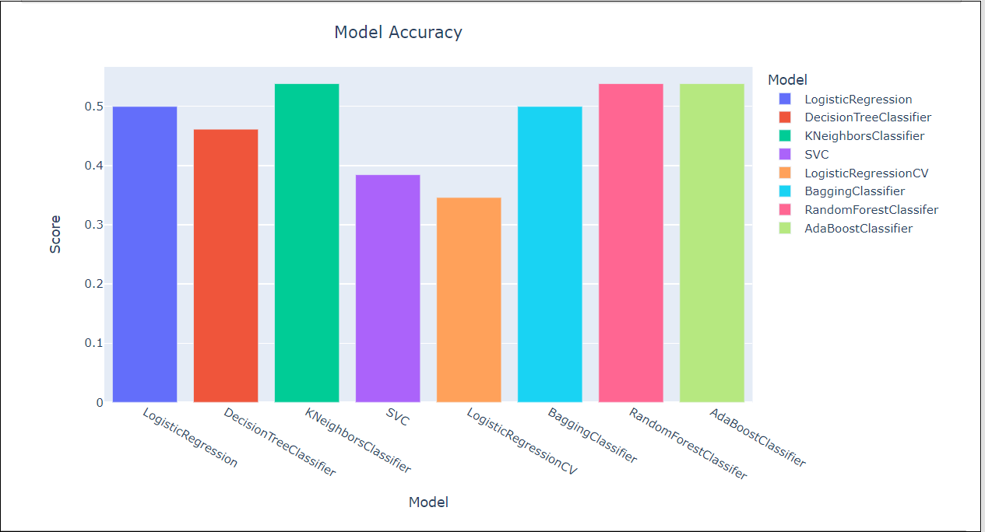
Full Data Analysis - Classic Classifiers - 1
Full analysis with 3 classes, deploying ‘classic’ ML/AI classifiers with hyperparameter tuning.
(computation details in Jupyter notebook ASubbaraman-CarnaticBeatAnalysis-3.ipynb)
Data was split into training (80%) and test (20%) data sets.
Model accuracy on the test data is shown below.
KNeighbors,
RandomForest,
AdaBoost:
accuracies ≅ 60%.
(Random guess = 33%)
Hyperparameters
KNeighbors : n_neighbors = 6
RandomForest: n_trees = 4
AdaBoost : n_estimators = 200
max_depth = 5

Slide 13
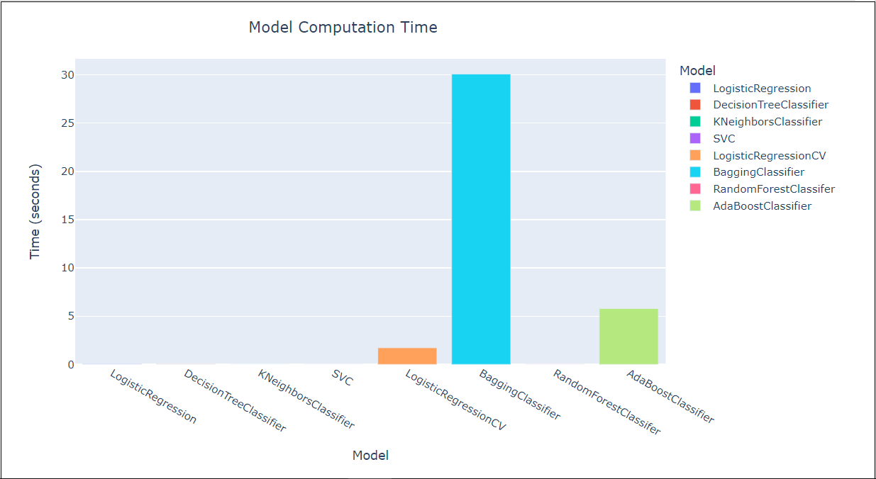
Full Data Analysis - Classic Classifiers - 2
Model computation time on the training data is shown below.
KNeighbors,
RandomForest:
Very speedy
(and among most accurate from previous slide)
AdaBoost:
Somewhat slower

Slide 14
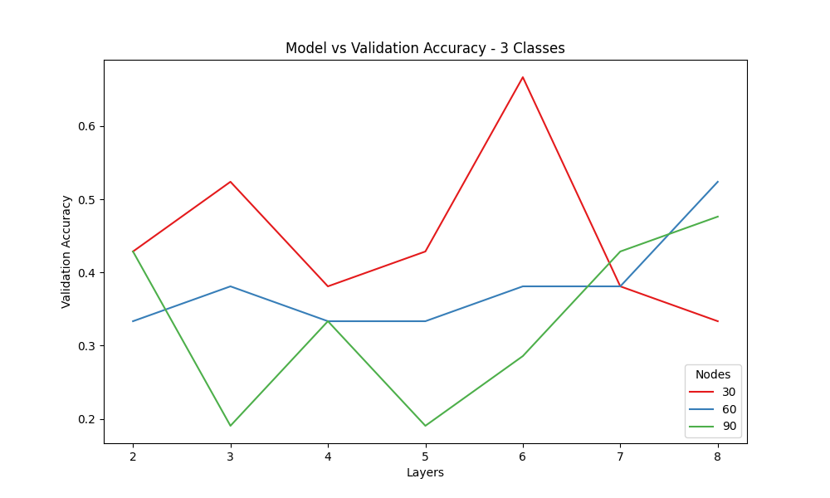
Full Data Analysis - Neural Nets
Search performed over Sequential networks to optimize number of hidden layers and number of nodes (neurons) in each layer. All layers have the same number of nodes.
(computation details in Jupyter notebook ASubbaraman-CarnaticBeatAnalysis_NN_3Classes.ipynb)
Epochs kept fixed at 100 from earlier analysis of accuracy vs epochs.
Accuracy on the test (validation) data are below.
Best-performing models have:
4 to 8 hidden layers.
30 - 60 nodes
Best performers are 50 to 66% accurate.

Slide 15
Discussion of Results
Comparison with Human Performance
Above ML/AI accuracy probably already exceeds a lay listener’s performance. Informal conversations indicate that a technical understanding of rhythm is quite hard for most people.
Probably will not match a Carnatic percussion expert’s accuracy.
Classic ML/AI classification tools have an accuracy of about 60% (random guess = 33%)
Neural networks have an accuracy of 50 to 66%.
About twice as accurate as random guess.
Results are preliminary due to the small dataset size and will most likely change as more data is generated.

Slide 16
Future Steps
Data, Data, Data!
Real estate adage: 3 most important aspects in real estate are location, location, location.
For an ML/AI project, one could say data, data, data.
Must increase the dataset size significantly, will require automated direct analysis of the mp3 audio file rather than manual image capture.
Shout out to the often under-appreciated art of high-quality data collection - perhaps overlooked these days when data can be downloaded with the click of a button.
How experts identify the beat: Feedback from a couple of percussion experts: Each beat cycle has signature rhythmic phrases. Experts identify rhythmic phrases embedded within a solo to identify the beat cycle.
This suggests that a filter-based neural network which filters (selects) rhythmic phrases, ie. a Convolutional Neural Network might be suitable for this task.

Slide 17
Acknowledgements
I would like to thank my family for helping me with the labor-intensive task of generating images of audio files. Without their generous investment of time, this project would not have been possible.

